Slide 1


Quantitative Trading
FX Market
L-S STRATEGY
By Haibo Xie

Slide 2


Intro & Purpose
Project
STEP 1 Fetch Features
Base portofolio feature retreival & Regression
Base portofolio’s constituents classification (based on regression)
OBJECTIVES
Overcoming Information Overload: Implement machine learning to analyze and classify the vast array of investment options, simplifying decision-making for retail investors overwhelmed by choices based on intuition or incomplete information
Enhancing Portfolio Efficiency: To construct portfolios that better align with the risk aversion typical of retail investors, aiming to reduce volatility and improve expected returns
STEP 2 Tradability
Target currency pairs classification
Identify forcastable currency pairs
STEP 3 Trading
Identify pairs for long and short by linear regression
Track the long short ratio for profitability measurement

Slide 3
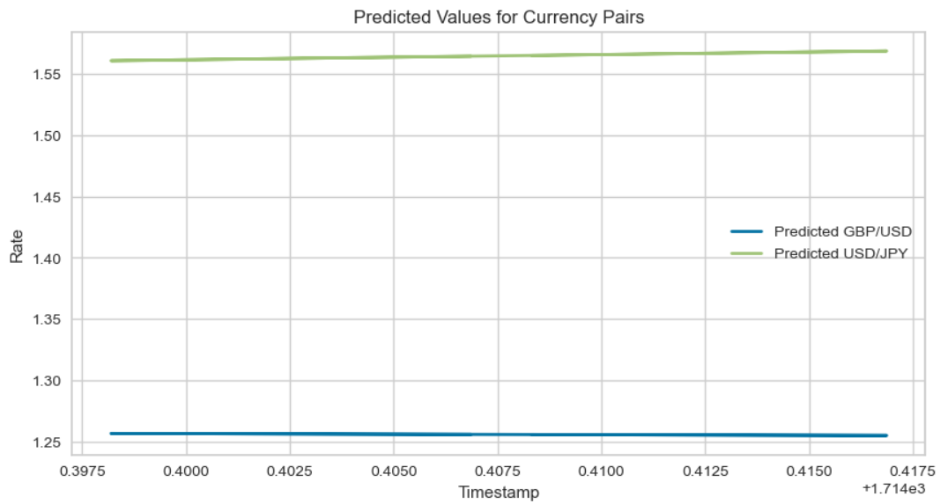
Intermediate Result
Portfolio Regression
Long-short Regression
Best Model: Linear regression
MSE for GBP/CHF: nearly a 0 Forecastable
MSE for EUR/USD: 0.0002079 Undefined
MSE for USD/CAD: 0.0004121 Non-forcastable
Target CPs Classification
(%) | Forecastable | Undefined | Non-Forecastable
EUR/CHF | 87.1 | 12.9 | /
EUR/CAD | / | / | 100
GBP/EUR | 100 | / | /
GBP/USD | / | / | 100
GBP/CAD | / | / | 100
USD/CHF | 100 | / | /
USD/JPY | / | 100 | /
Decision:
Long: USD/JPY
Short: GBP/USD

Slide 4
Results & Improves
Trading Results
Improvements
3-HOURS
FUTURE
First investment
Return: 0.1511%
Reinvestment 1
Return: 0.1076%
Reinvestment 2
Return: 0.1052%
Calculate portfolio correlations using a weighted average price, rather than averaging constituent correlations, for greater accuracy
Base portfolio should construct by more currency pairs to be more diversified
Regularly rebalance trading portfolio over time to prevents strategy distortion
Determine he entery point and exist point based on FD and volatility, and other indicators that can estimate the direction of movements
Total Return: 0.3639%
Avg Return: 0.1213%

Slide 5
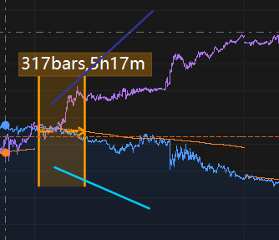
Appendix

